Slide 1
Convolution Neural Networks

Slide 2
1. Linear regression 2. Multilayer perceptron 3. Convolutional neural network 4. Data processing

Slide 3
Linear regression

Slide 4
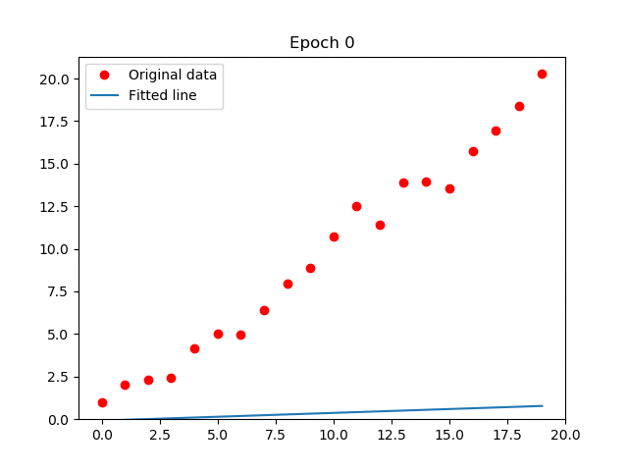
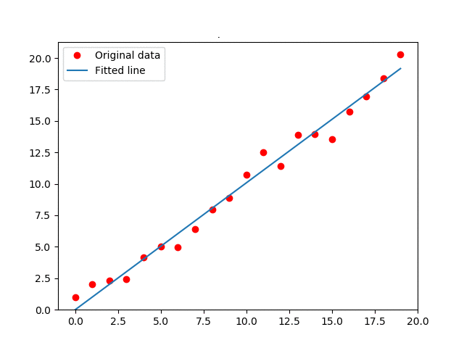
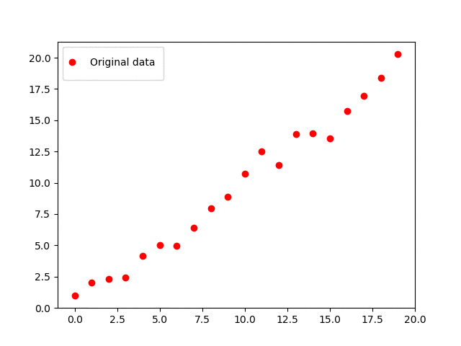
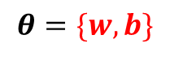
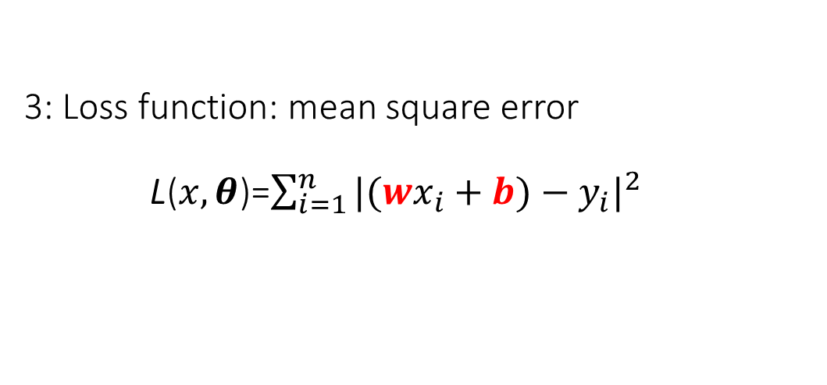
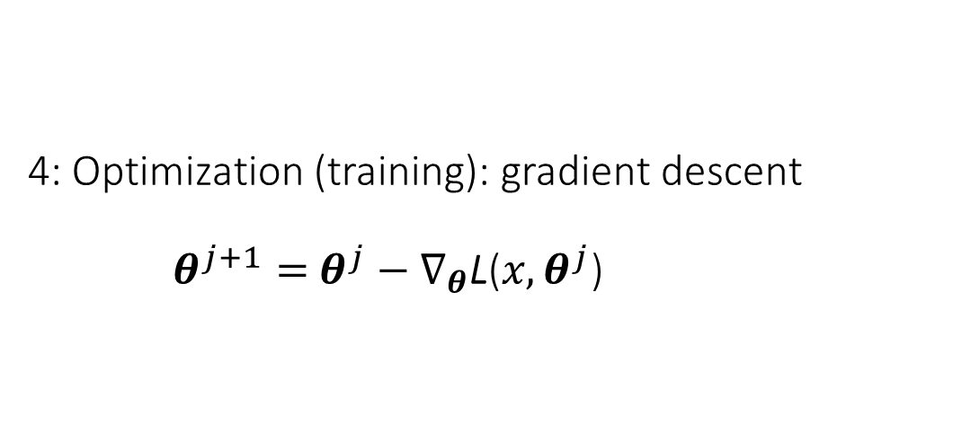
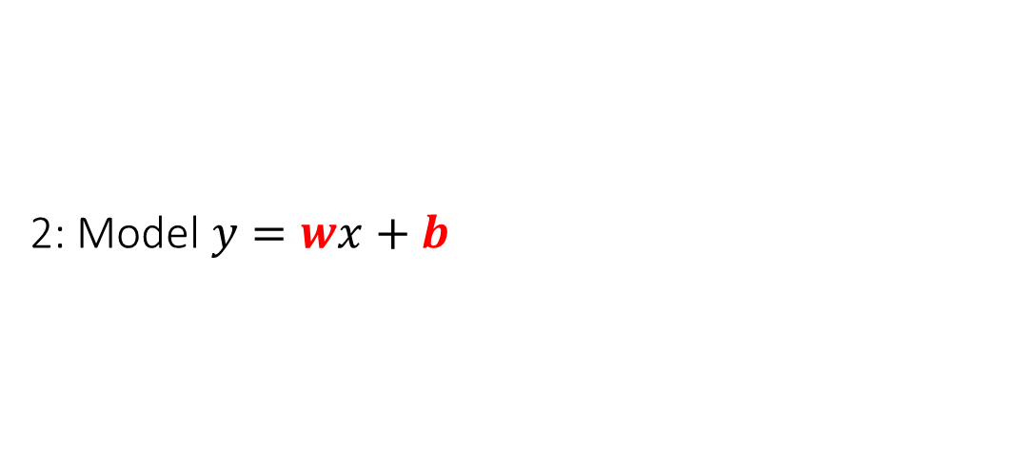
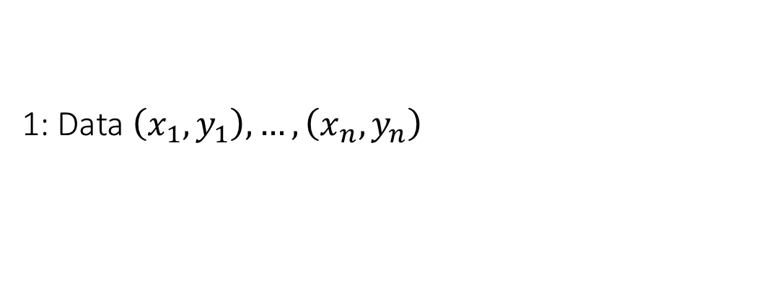
Linear regression
Math behind:
1: Data $\left(x_{1},y_{1}\right),…,\left(x_{n},y_{n}\right)$
2: Model $y=wx+b$
3: Loss function: mean square error
L($x, θ$)=$\sum_{i=1}^{n}{|(wx_{i}+b)−y_{i}|^{2}}$
4: Optimization (training): gradient descent
$θ^{j+1}=$ $θ^{j}−∇_{θ}\text{L}\text{(}x,θ^{j}\text{)}$
5: Inference (inference)
$$θ=\{w,b\}$$

Slide 5
Multilayer perceptron

Slide 6
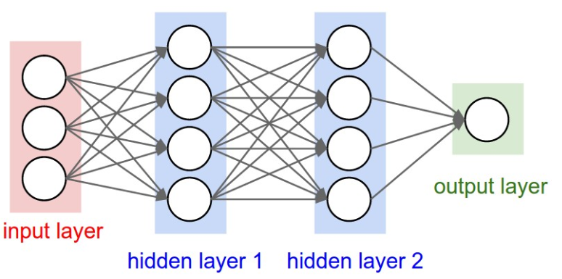
Multilayer perceptron
Model
Data (eg. Images, sounds)
Loss
Data (eg. labels)

Slide 7
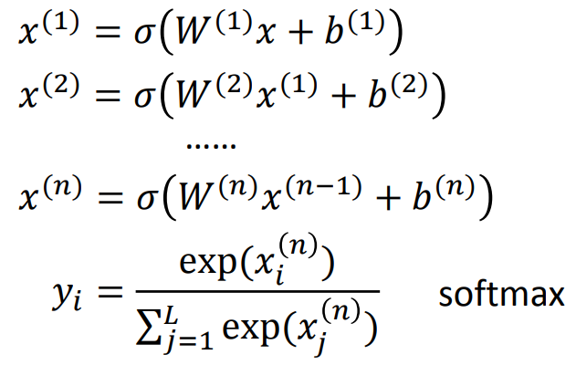
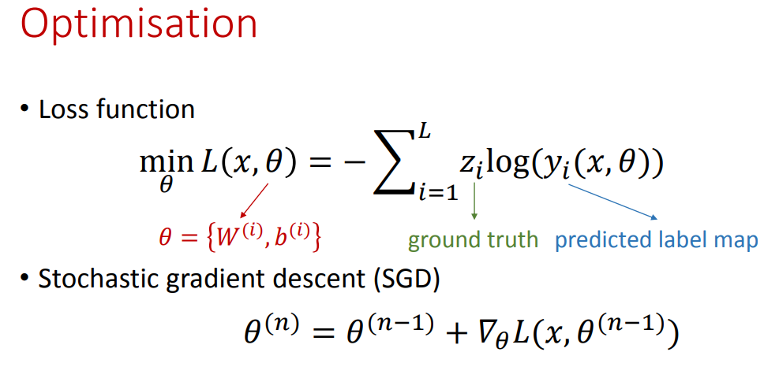
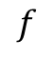
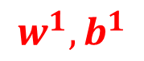
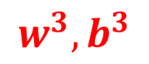
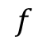
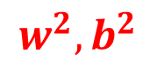
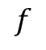
Multilayer perceptron
$$f$$
$$f$$
$$f$$
$$w^{1},b^{1}$$
$$w^{2},b^{2}$$
$$w^{3},b^{3}$$
For classification
labels

Slide 8
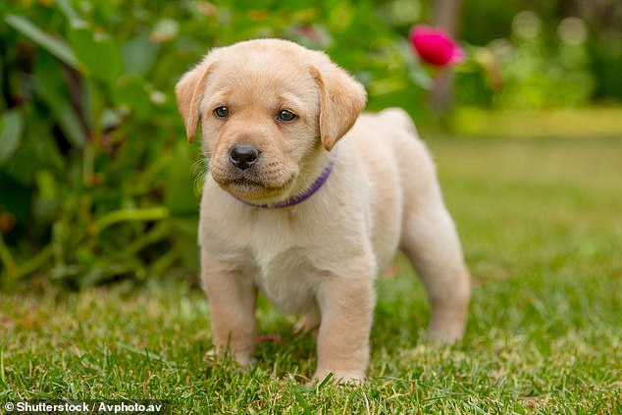
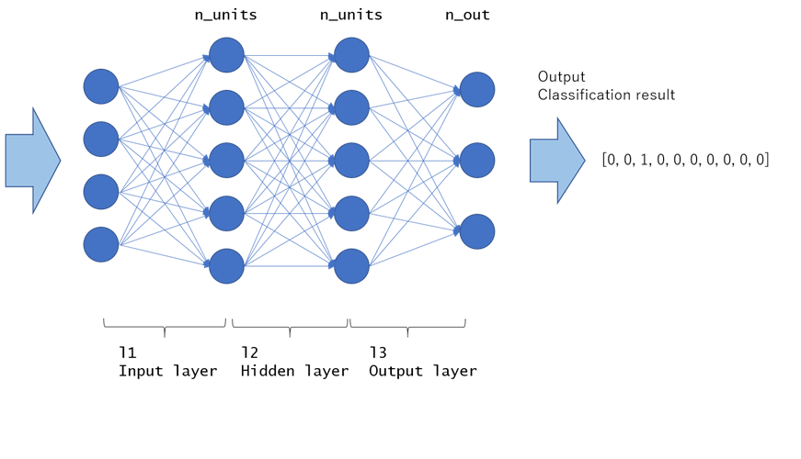
We need 250k number of weights/parameters to map the input to a single neuron. Too expensive!
500x500 pixels

Slide 9
Convolutional Neural Network

Slide 10
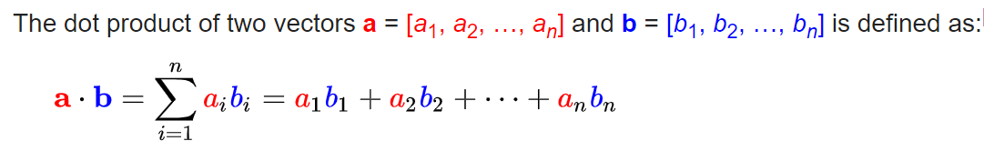


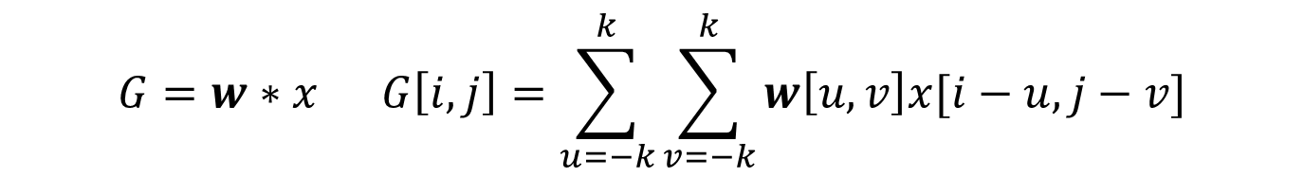
Dot product and convolution
The convolution between an image $x$ and a kernel $w$ is given as
$$G=w∗x G\left[i,j\right]=\sum_{u=−k}^{k}{\sum_{v=−k}^{k}{w\left[u,v\right]x[i−u,j−v]}}$$
Where $u,v$ are indices in the kernel grid and $i,j$are indices in the image grid. $k$ denotes the radius of the kernel.

Slide 11
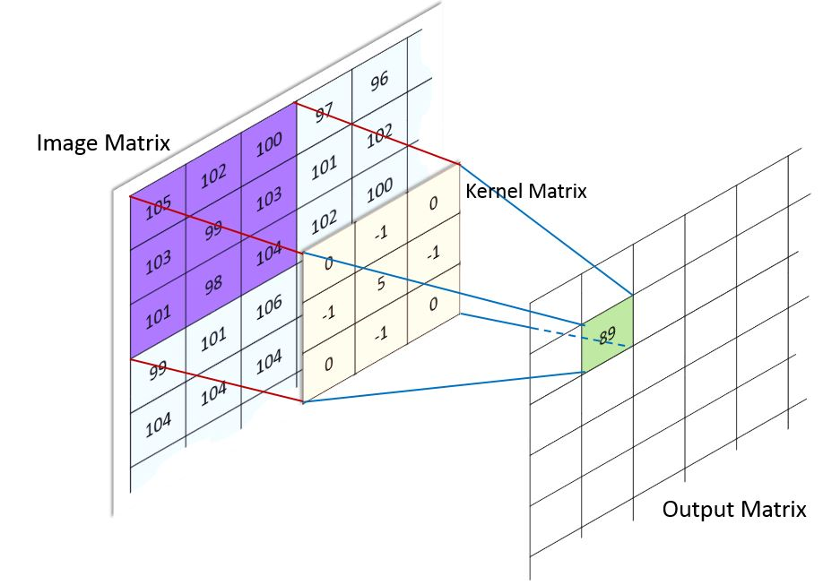
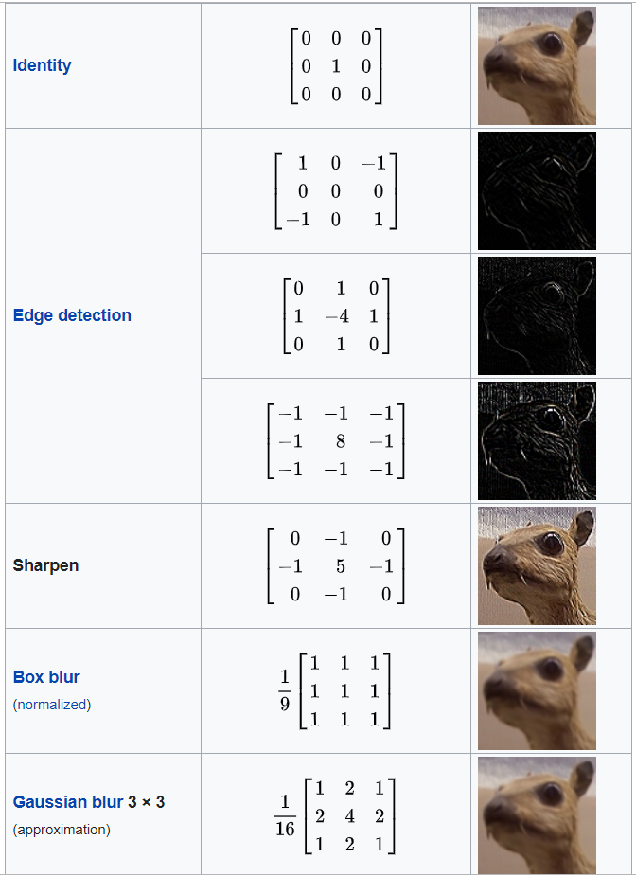
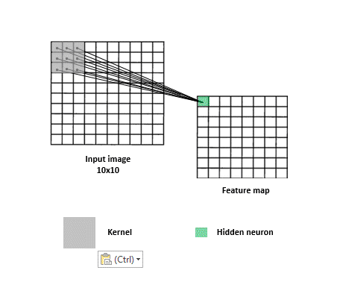
Convolutional Neural Network
Depending on values, a kernel can cause a wide range of effects
dot product
followed by activation function f
Image matrix
convolution
Kernel

Slide 12
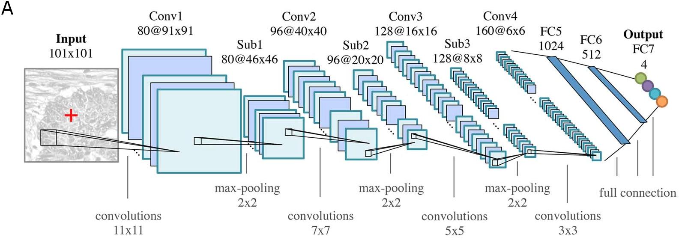
Convolutional Neural Network

Slide 13
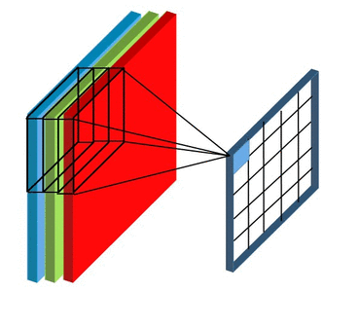
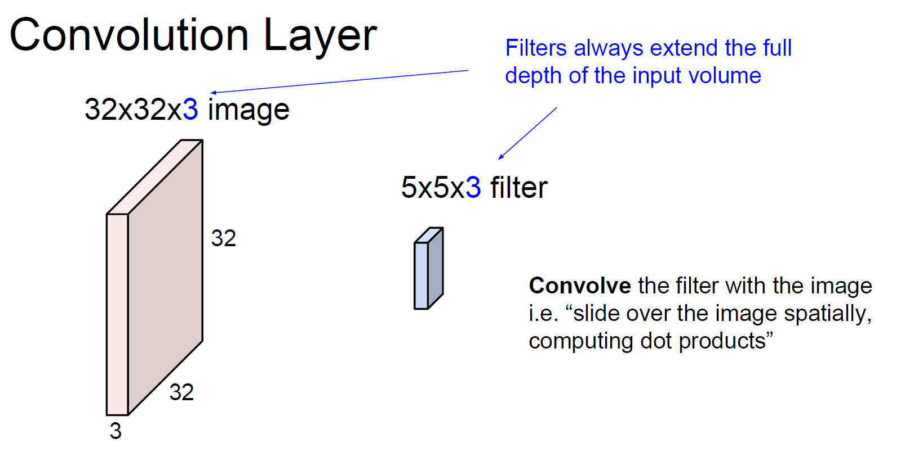

Slide 14
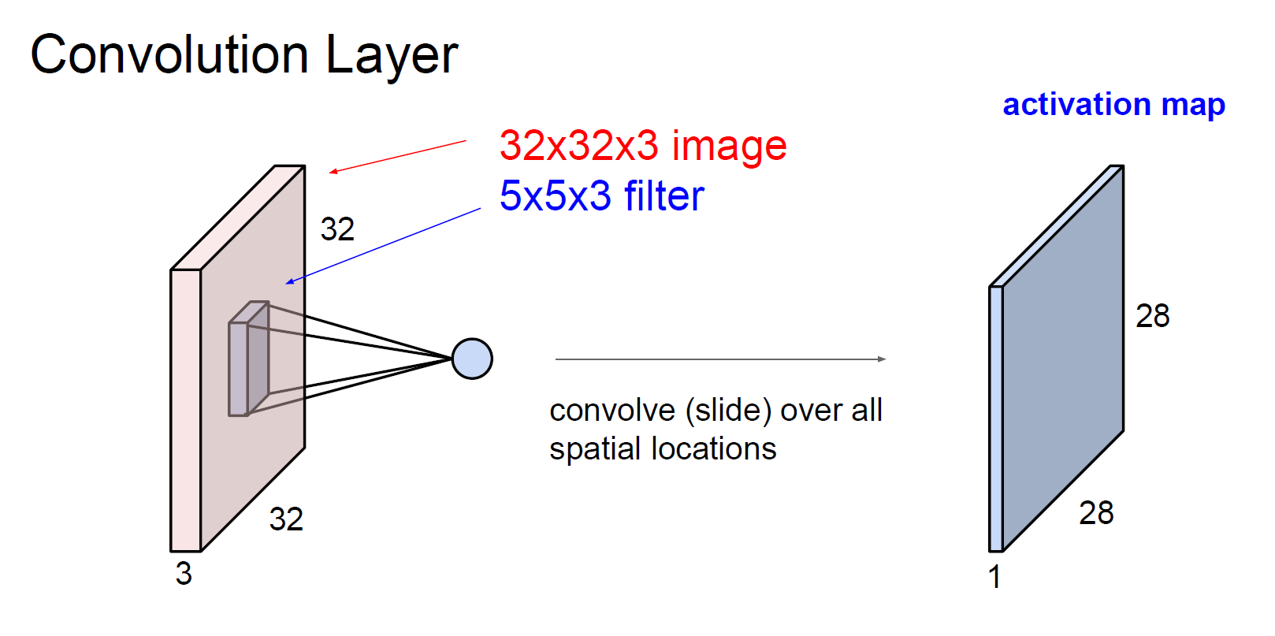

Slide 15
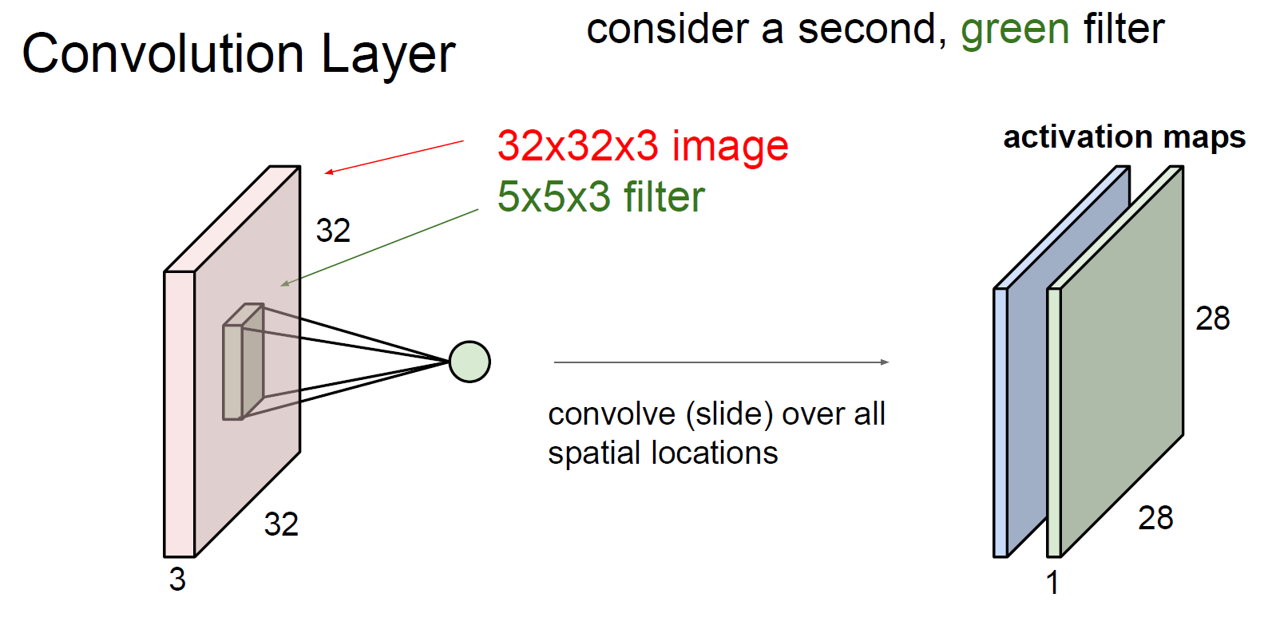

Slide 16
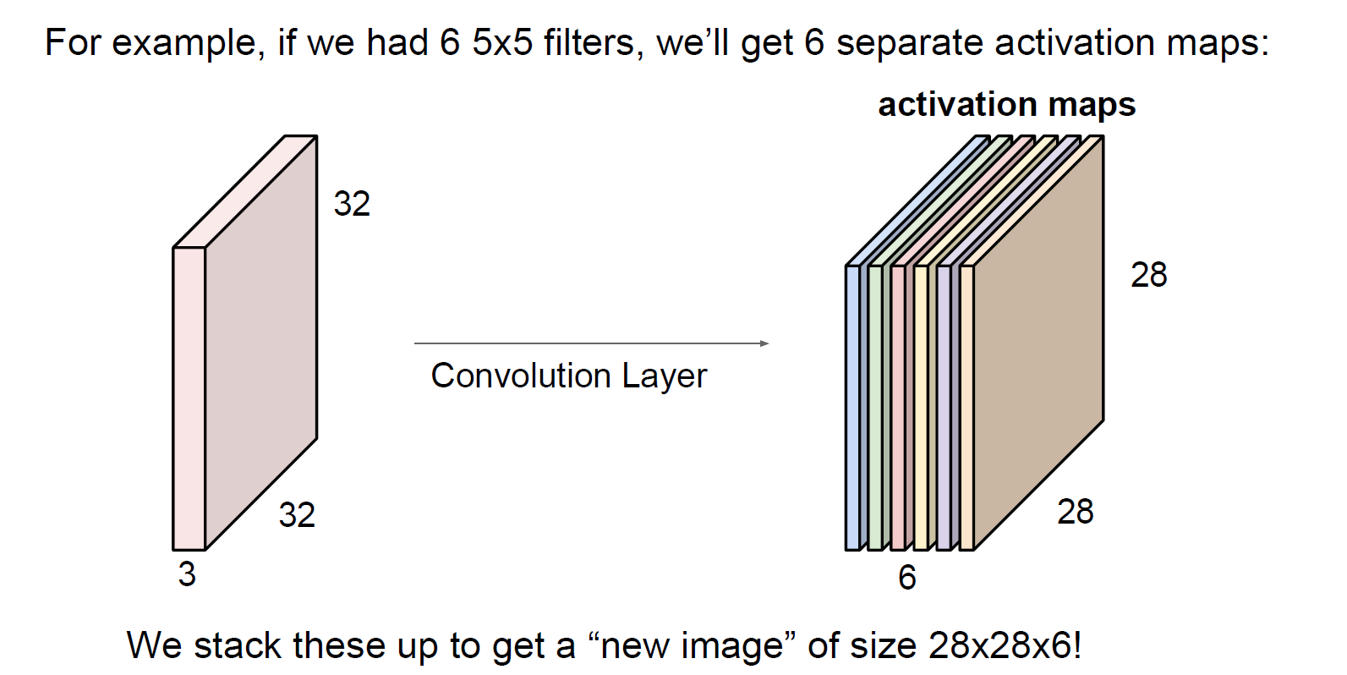

Slide 17
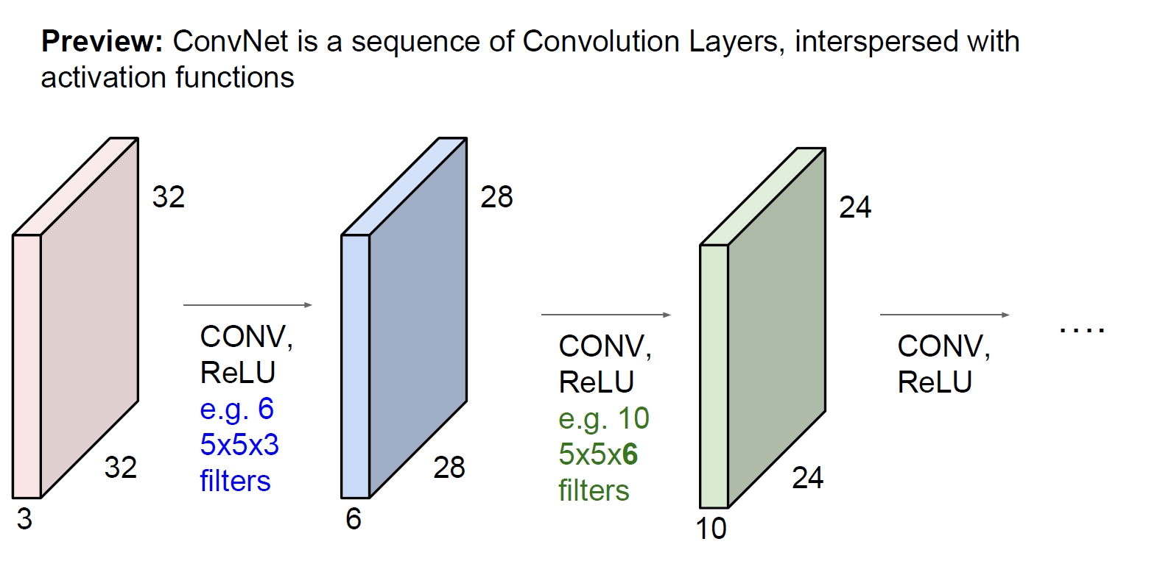

Slide 18
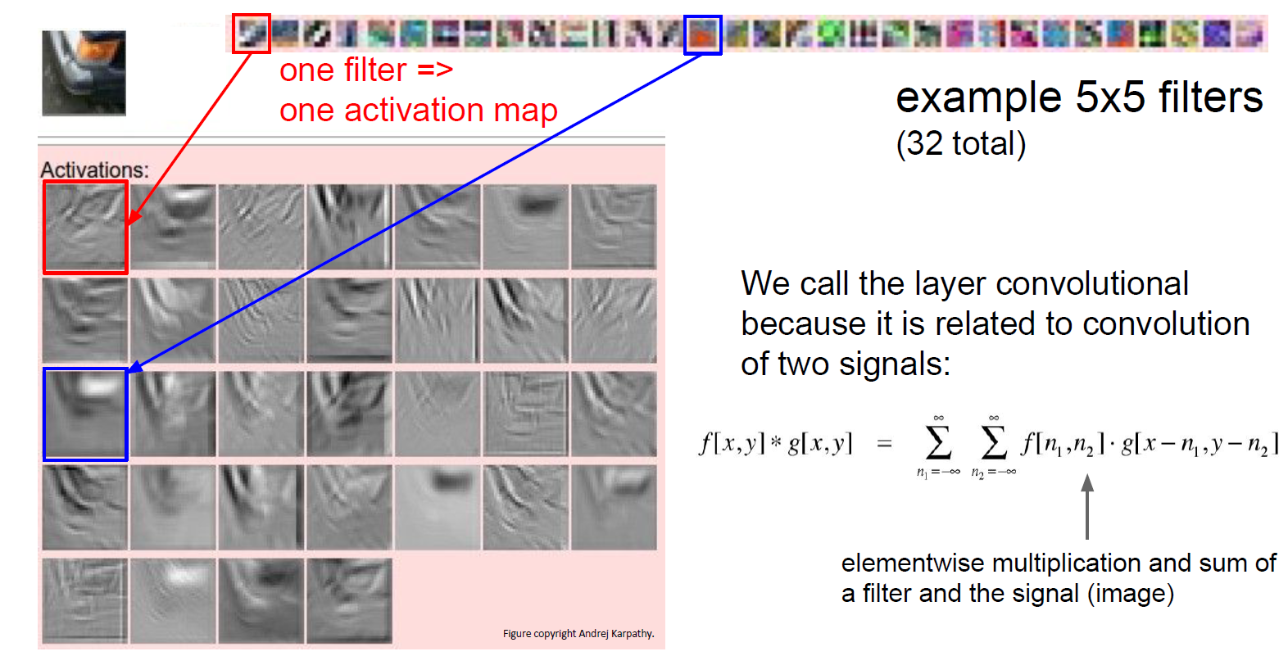
https://cs.stanford.edu/people/karpathy/convnetjs/demo/cifar10.html

Slide 19
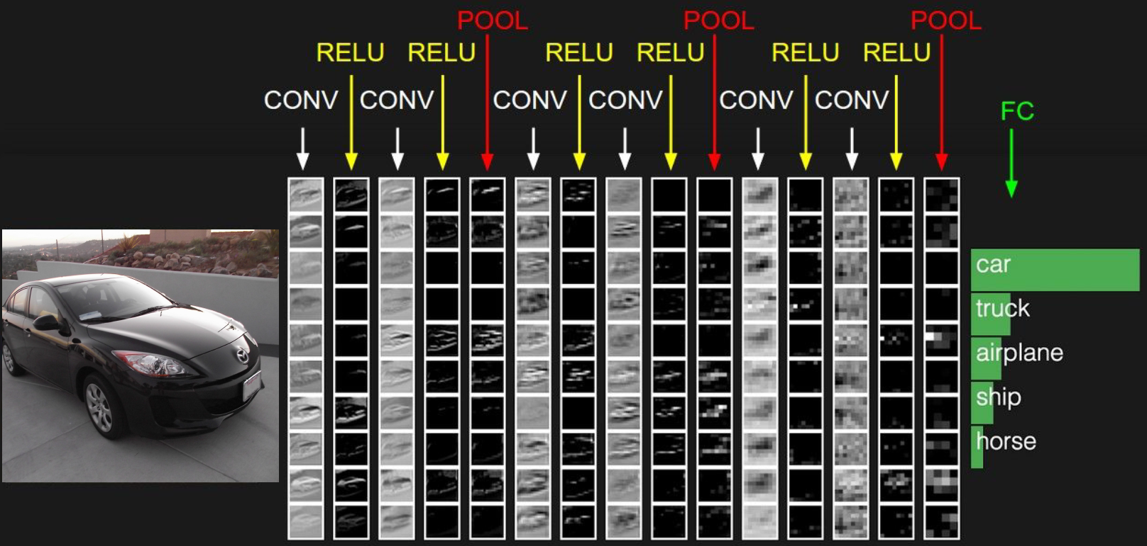

Slide 20
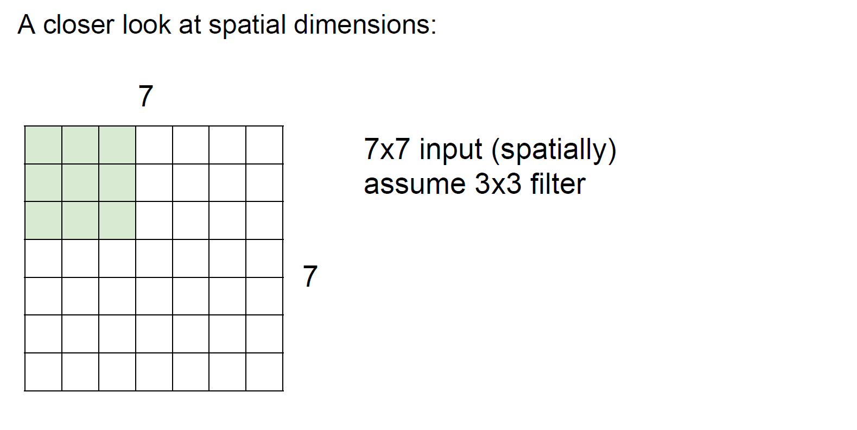

Slide 21
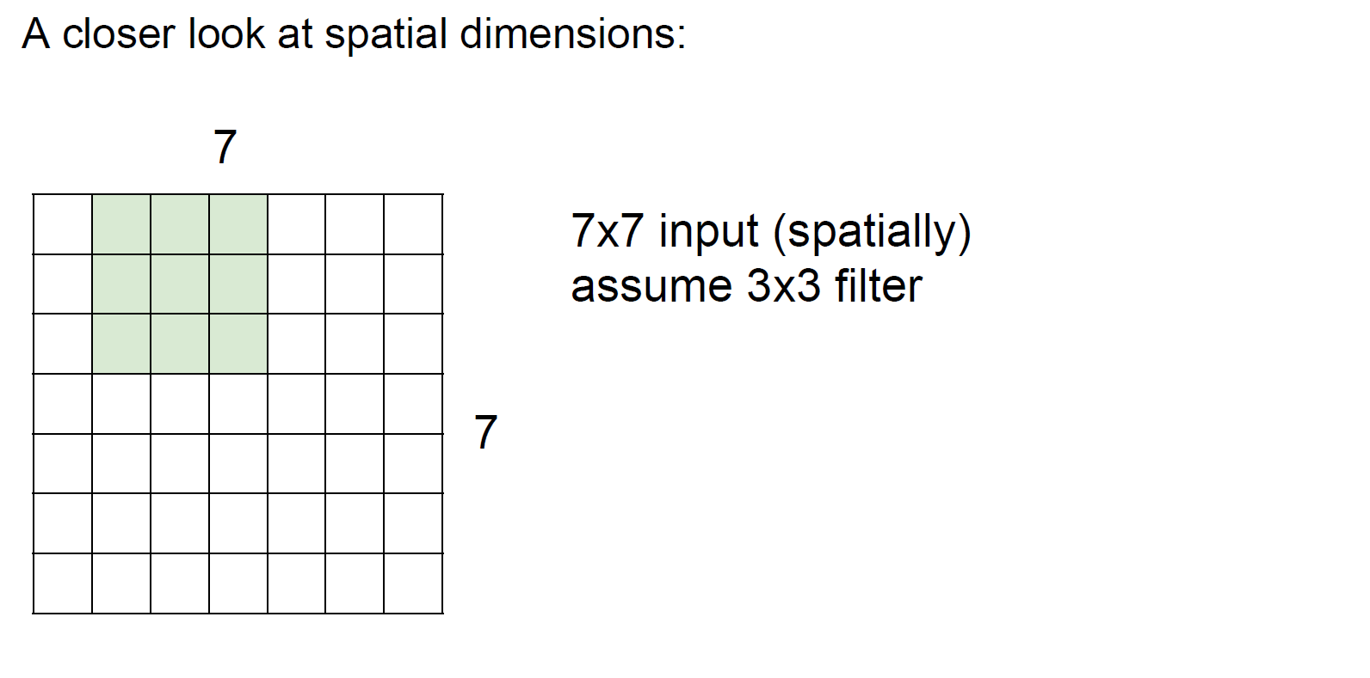

Slide 22
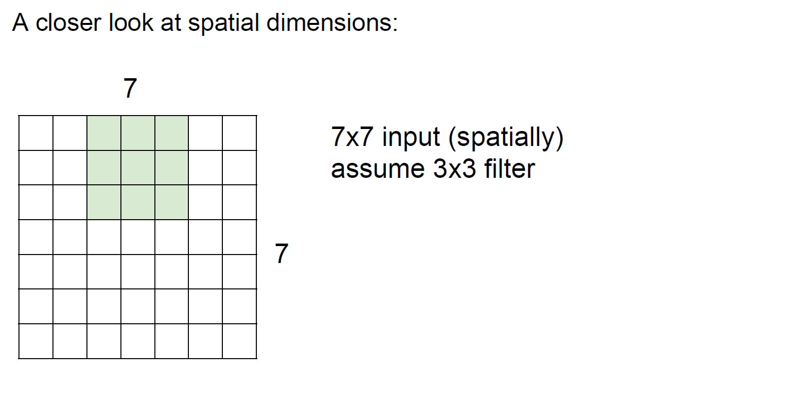

Slide 23
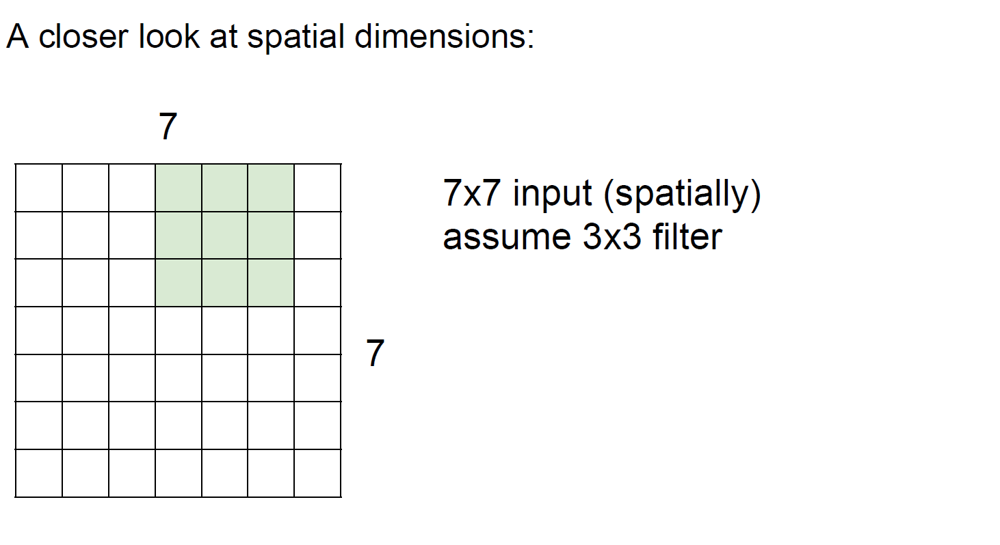

Slide 24


Slide 25
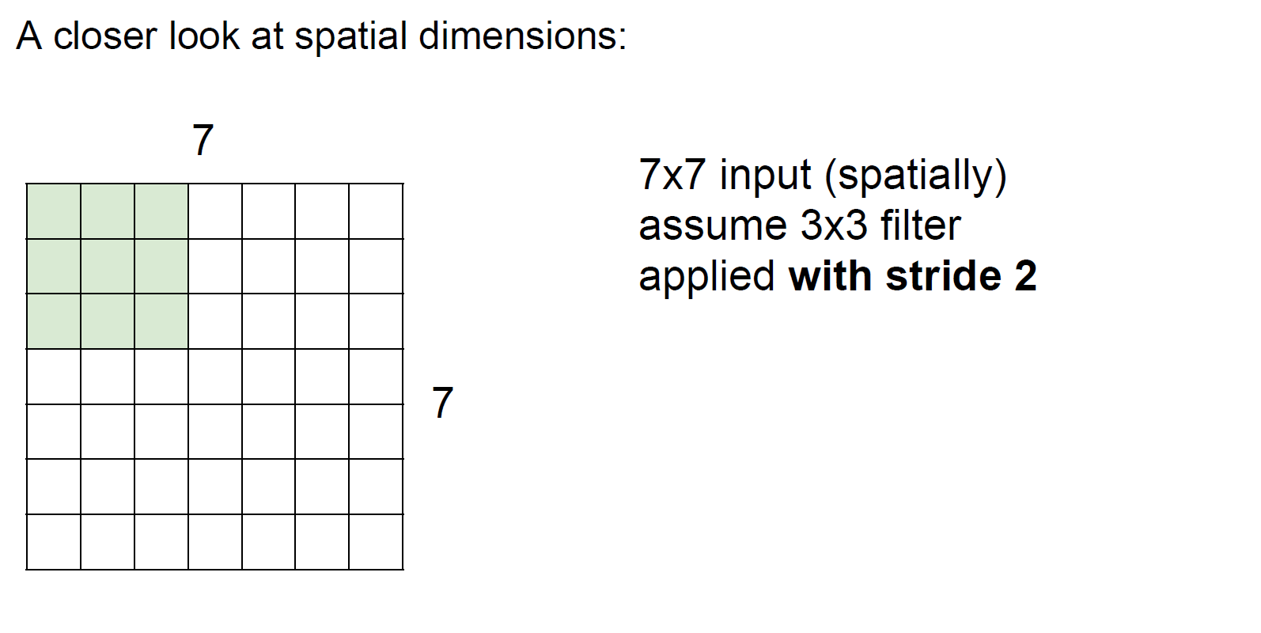

Slide 26
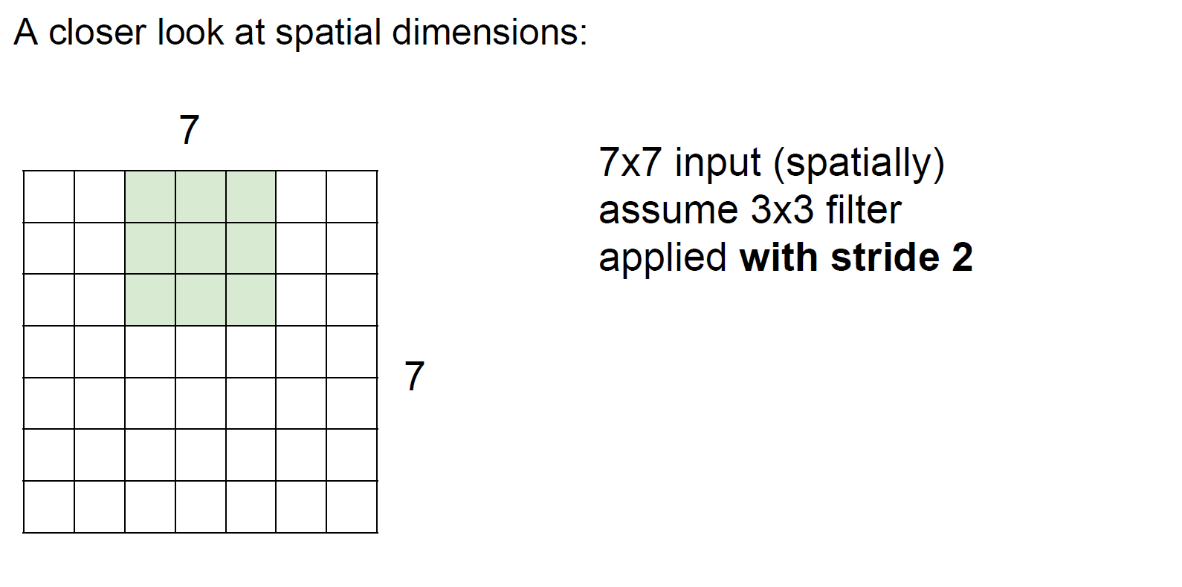

Slide 27
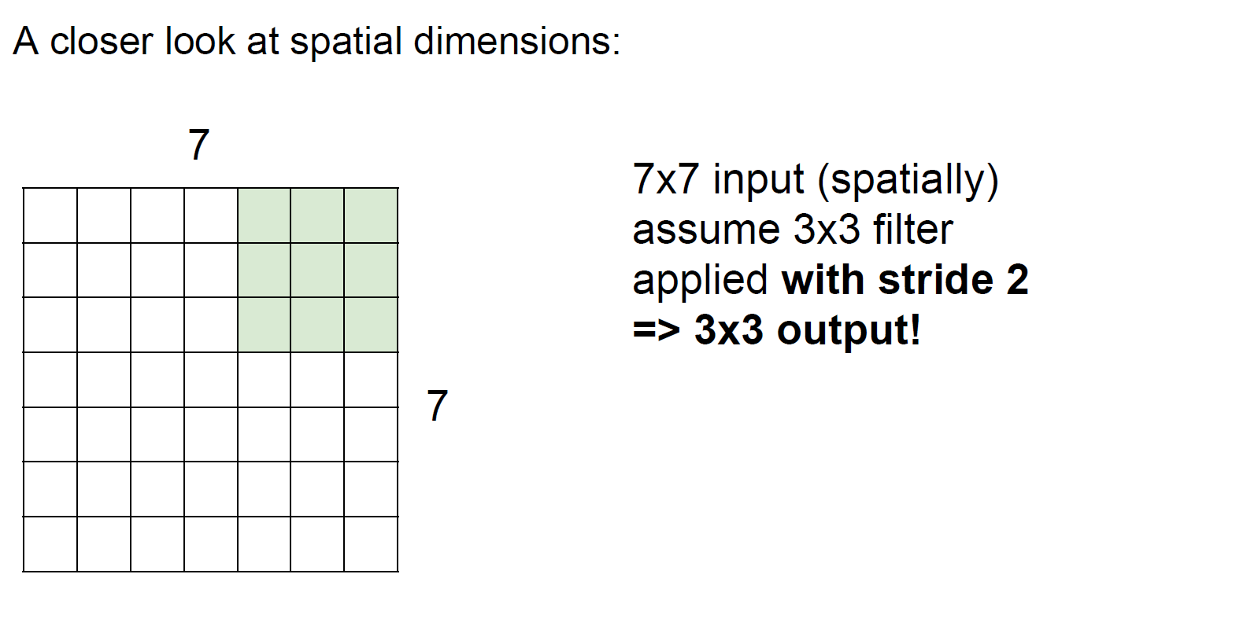

Slide 28


Slide 29
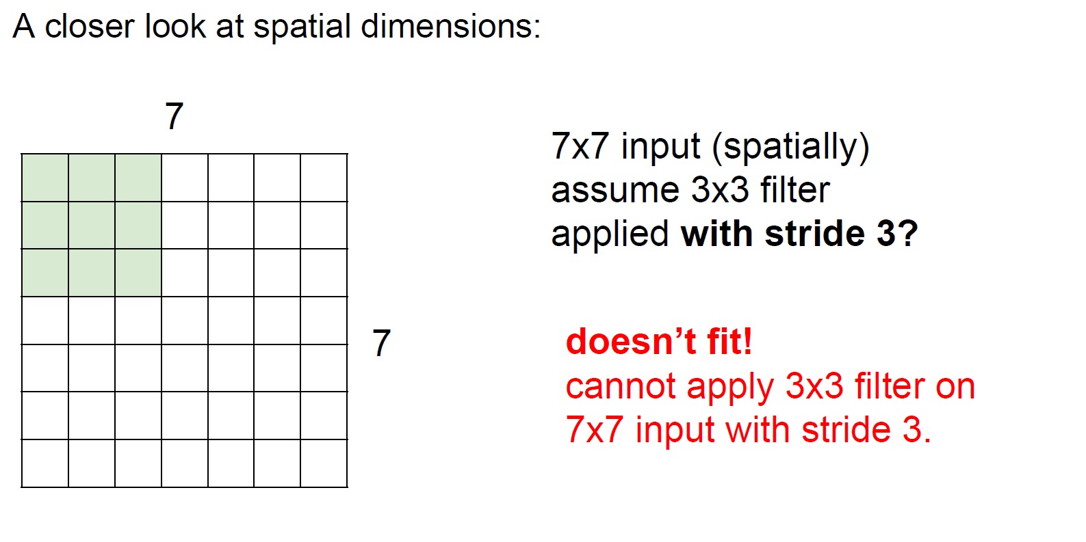

Slide 30
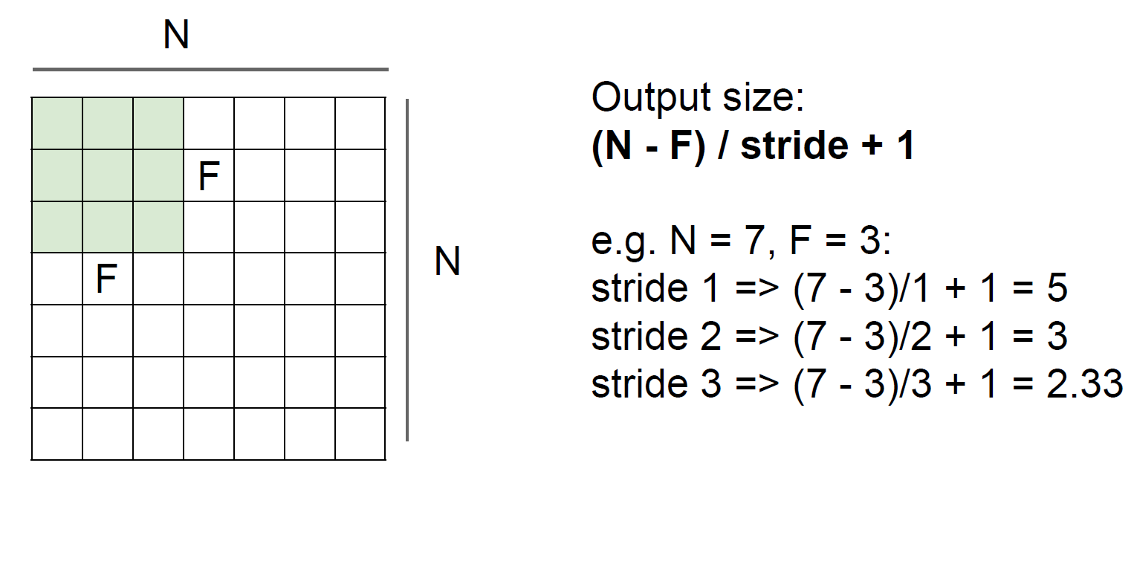

Slide 31
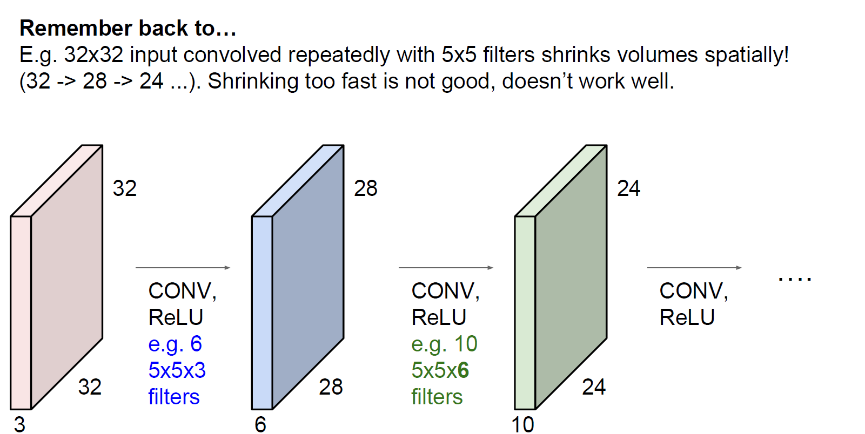

Slide 32
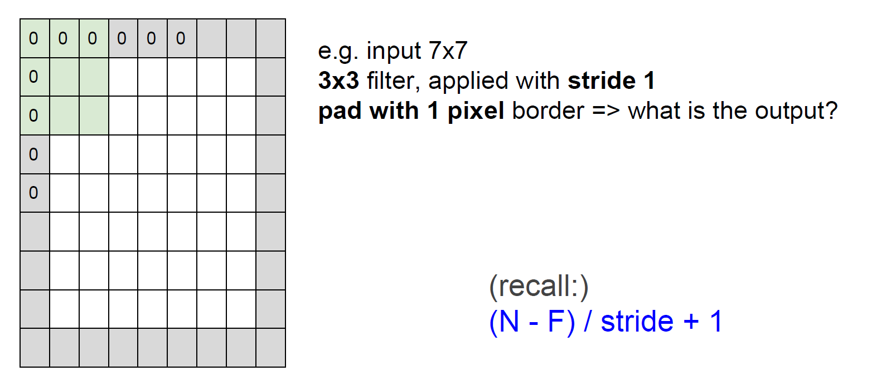
How to keep spatial size: zero paddings

Slide 33
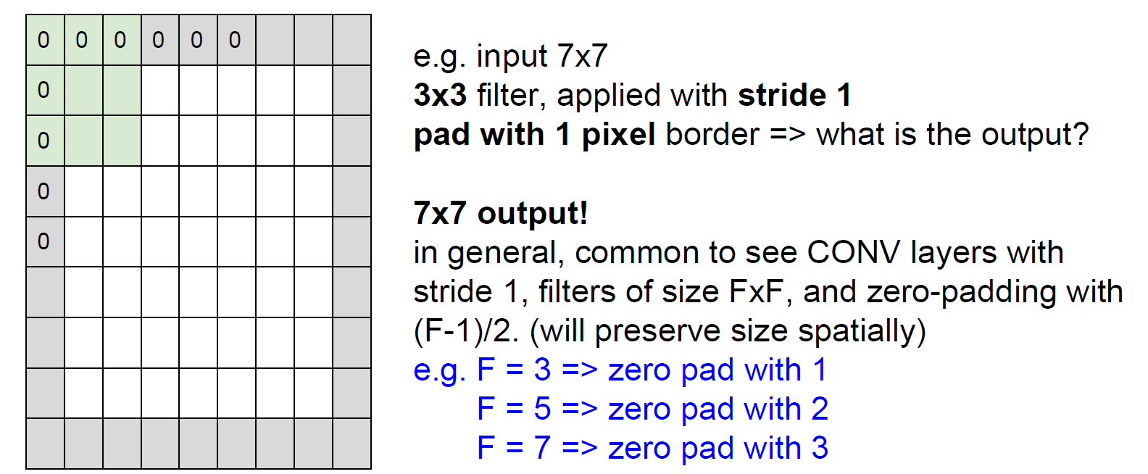
How to keep spatial size: zero paddings

Slide 34
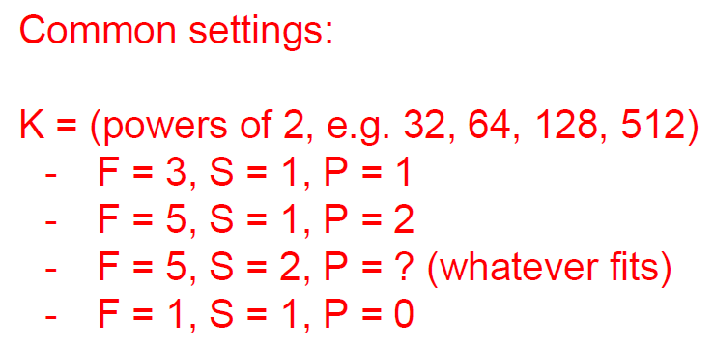
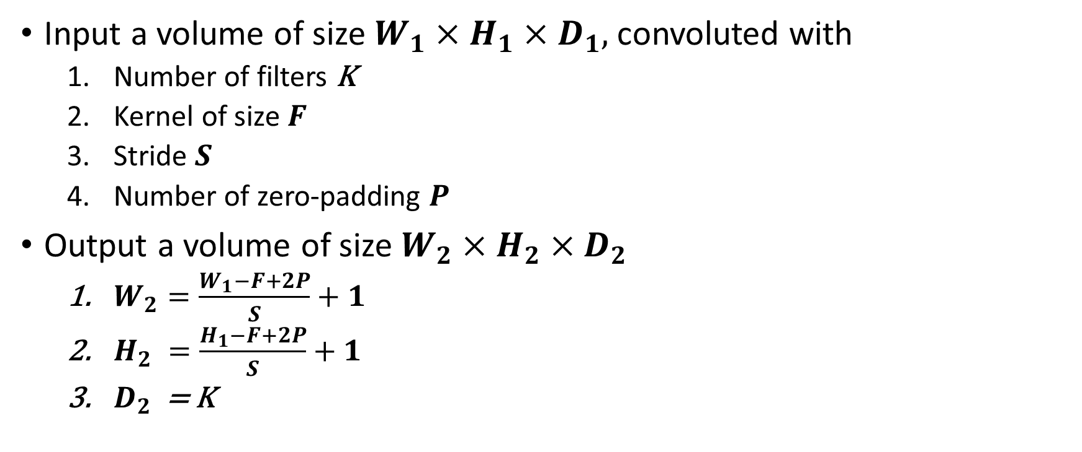
Magic formula (output volume size)
Input a volume of size $W_{1}×H_{1}×D_{1},$convoluted with
Number of filters K
Kernel of size $F$
Stride $S$
Number of zero-padding $P$
Output a volume of size $W_{2}×H_{2}×D_{2}$
$W_{2}=\frac{W_{1}−F+2P}{S}+1$
$H_{2} =\frac{H_{1}−F+2P}{S}+1$
$D_{2}$ = K

Slide 35
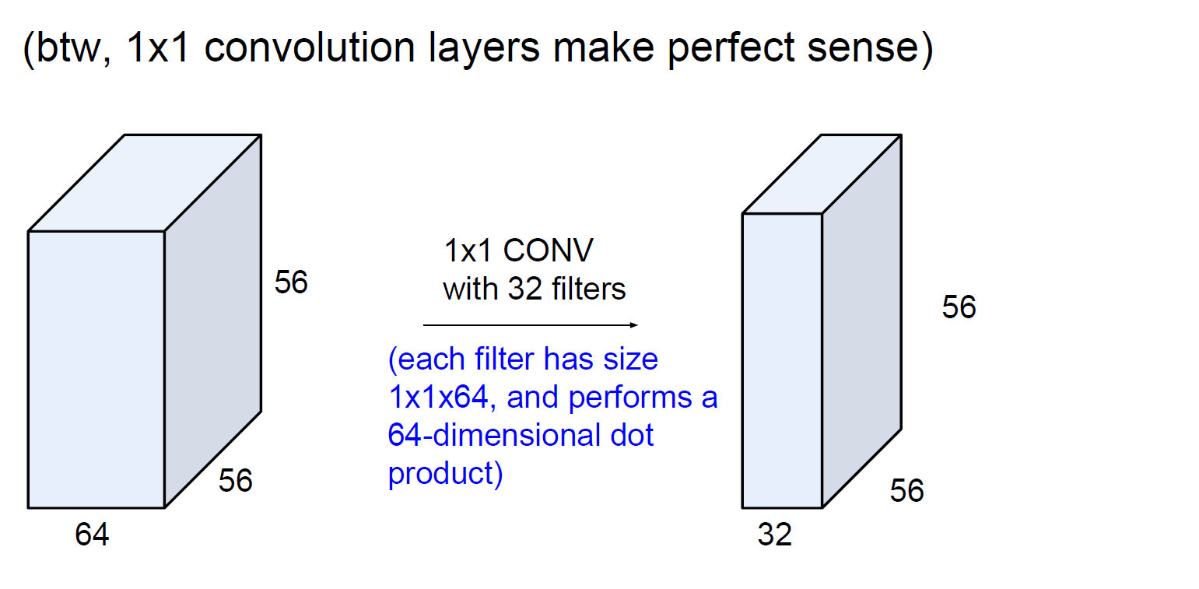

Slide 36
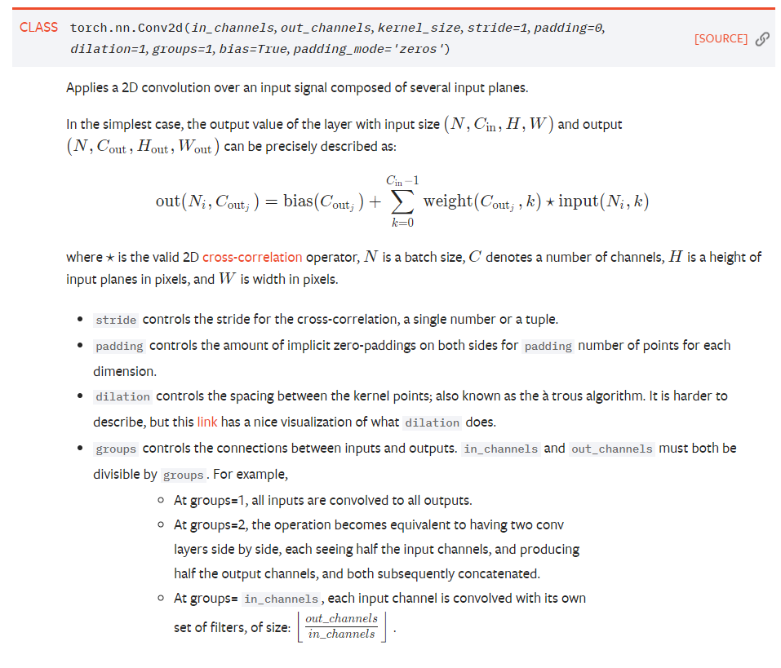
https://pytorch.org/docs/stable/nn.html

Slide 37
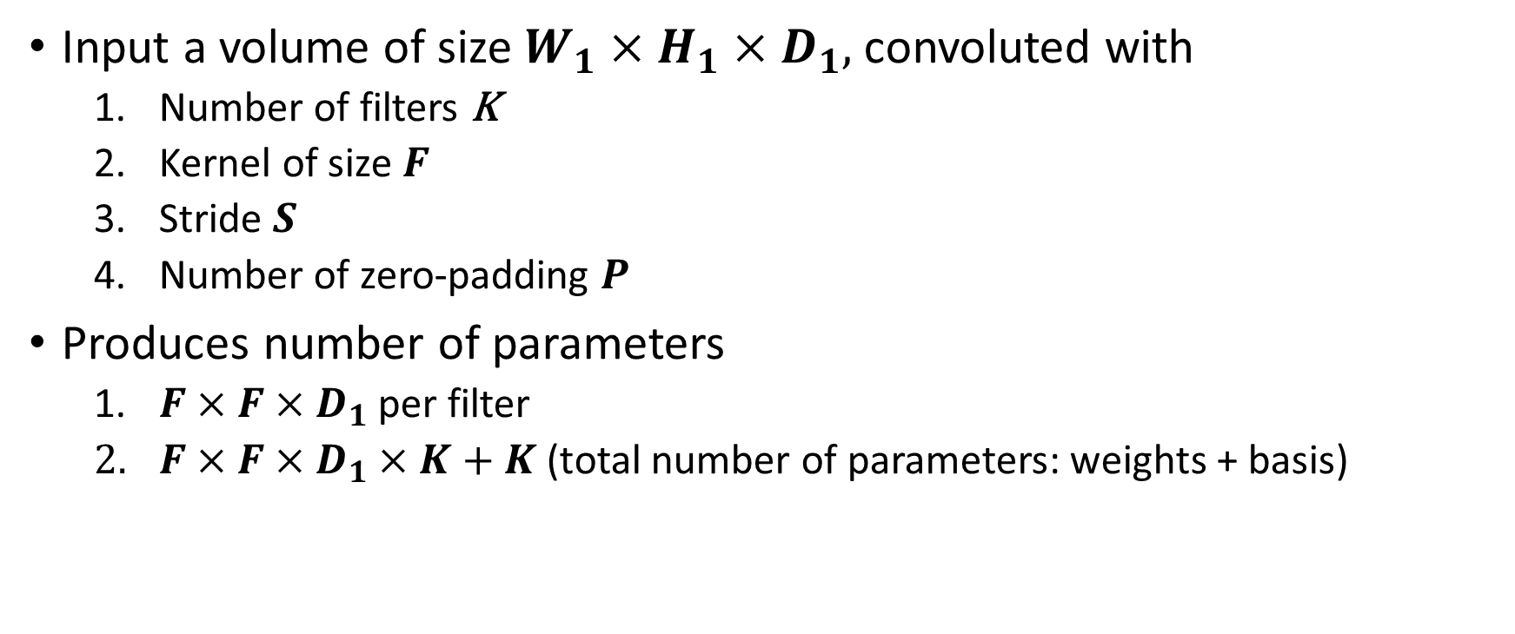
Magic formula (number of parameters)
Input a volume of size $W_{1}×H_{1}×D_{1},$convoluted with
Number of filters K
Kernel of size $F$
Stride $S$
Number of zero-padding $P$
Produces number of parameters
$F×F×D_{1}$per filter
$F×F×D_{1}×K+K$(total number of parameters: weights + basis)

Slide 38


Slide 39


Slide 40


Slide 41


Slide 42


Slide 43


Slide 44


Magic formula (output volume size after pooling)
Input a volume of size $W_{1}×H_{1}×D_{1},$convoluted with
Kernel of size $F$
Stride $S$
Output a volume of size $W_{2}×H_{2}×D_{2}$
$W_{2}=\frac{W_{1}−F}{S}+1$
$H_{2} =\frac{H_{1}−F}{S}+1$
$D_{2} \text{= }D_{1}$

Slide 45

Case study: VGG16 for ImageNet classification
zero-padding size = 1
1000

Slide 46
Case study: VGG16 for ImageNet classification
Input size = 224x224x3
zero-padding size = 1
1000

Slide 47
Case study: VGG16 for ImageNet classification
Input size = 224x224x3
zero-padding size = 1
1000
224x224x64
(3x3x3)x64+64

Slide 48
Case study: VGG16 for ImageNet classification
Input size = 224x224x3
zero-padding size = 1
1000
224x224x64
(3x3x64)x64+64

Slide 49
Case study: VGG16 for ImageNet classification
Input size = 224x224x3
zero-padding size = 1
1000
112x112x64
0

Slide 50
Case study: VGG16 for ImageNet classification
Input size = 224x224x3
zero-padding size = 1
1000
112x112x128
(3x3x64)x128+128

Slide 51
Case study: VGG16 for ImageNet classification
Input size = 224x224x3
zero-padding size = 1
1000
112x112x128
(3x3x128)x128+128

Slide 52
Case study: VGG16 for ImageNet classification
Input size = 224x224x3
zero-padding size = 1
1000
56x56x128
0

Slide 53
Case study: VGG16 for ImageNet classification
Input size = 224x224x3
zero-padding size = 1
1000
56x56x256
(3x3x128)x256+256

Slide 54
Case study: VGG16 for ImageNet classification
Input size = 224x224x3
zero-padding size = 1
1000
56x56x256
(3x3x256)x256+256

Slide 55
Case study: VGG16 for ImageNet classification
Input size = 224x224x3
zero-padding size = 1
1000
56x56x256
(3x3x256)x256+256

Slide 56
Case study: VGG16 for ImageNet classification
Input size = 224x224x3
zero-padding size = 1
1000
28x28x256
0

Slide 57
Case study: VGG16 for ImageNet classification
Input size = 224x224x3
zero-padding size = 1
1000
28x28x512
(3x3x256)x512+512

Slide 58
Case study: VGG16 for ImageNet classification
Input size = 224x224x3
zero-padding size = 1
1000
28x28x512
(3x3x512)x512+512

Slide 59
Case study: VGG16 for ImageNet classification
Input size = 224x224x3
zero-padding size = 1
1000
28x28x512
(3x3x512)x512+512

Slide 60
Case study: VGG16 for ImageNet classification
Input size = 224x224x3
zero-padding size = 1
1000
14x14x512
0

Slide 61
Case study: VGG16 for ImageNet classification
Input size = 224x224x3
zero-padding size = 1
1000
14x14x512
(3x3x512)x512+512

Slide 62
Case study: VGG16 for ImageNet classification
Input size = 224x224x3
zero-padding size = 1
1000
14x14x512
(3x3x512)x512+512

Slide 63
Case study: VGG16 for ImageNet classification
Input size = 224x224x3
zero-padding size = 1
1000
14x14x512
(3x3x512)x512+512

Slide 64
Case study: VGG16 for ImageNet classification
Input size = 224x224x3
zero-padding size = 1
1000
7x7x512
0

Slide 65
Case study: VGG16 for ImageNet classification
Input size = 224x224x3
zero-padding size = 1
1000
1x1x4096
(7x7x512)x4096+4096

Slide 66
Case study: VGG16 for ImageNet classification
Input size = 224x224x3
zero-padding size = 1
1000
1x1x4096
4096x4096+4096

Slide 67
Case study: VGG16 for ImageNet classification
Input size = 224x224x3
zero-padding size = 1
1000
1x1x1000
4096x1000+1000
Total parameters: 138M

Slide 68
CNN: Continue

Slide 69


Slide 70

Many others

Slide 71


Slide 72

(x’, y’, w’, h’)

Slide 73

2

Slide 74


Slide 75


Slide 76


Slide 77

Ground truth
Cross Entropy loss

Slide 78


Slide 79


Slide 80


Slide 81


Slide 82



Slide 83

Magic formula (output size after upsampling)
Input a volume of size $W_{1}×H_{1}×D_{1},$convoluted with
Number of filters K
Kernel of size $F$
Stride $S$
Number of zero-padding $P$
Number of output padding $OP$
Output a volume of size $W_{2}×H_{2}×D_{2}$
$W_{2}={(W}_{1}−1)×S−2×P+(F−1)+1+OP$
$H_{2} ={(H}_{1}−1)×S−2×P+(F−1)+1+OP$
$D_{2} \text{= }K$

Slide 84
Data preprocessing

Slide 85


Before normalization, loss is sensitive to changes in model parameters, hard to optimize
After normalization, loss is less sensitive to changes in model parameters, easier to optimize

Slide 86



Z-score
Min-Max
$$\text{=}\frac{value−min}{max−min}$$
$$=\frac{value−mean}{std}$$
Z-score normalization: Handles outliers, but does not produce normalized data with the exact same scale.
Min-max normalization: Guarantees all features will have the exact same scale but does not handle outliers well

Slide 87

Less used in convolutional neural network

Slide 88
Terminologies
Batch
Epoch
Stochastic gradient descent
Neuron
Activation/feature map
Activation function
Channels/depth
Respective field
Hidden layer (including many activation maps)
Parameter
Hyperparameter
Network architecture
Inference (deployment)
Forward pass
Backward propagation

Slide 89
References for these slides
http://cs231n.stanford.edu/
https://medium.com/apache-mxnet/transposed-convolutions-explained-with-ms-excel-52d13030c7e8
http://makeyourownneuralnetwork.blogspot.com/2020/02/calculating-output-size-of-convolutions.html
https://pytorch.org/docs/stable/generated/torch.transpose.html
https://arxiv.org/pdf/1409.1556.pdf

